Slide 1

A Project Report On
Food mania
Post-Graduation
MCA / M. Sc. IT / Integrated M. Sc. IT Silver Oak College of Computer Application
Submitted to
Department of Masters
Silver Oak College of Computer Application Silver Oak University
Submitted By:
Tejas gangani-2304070200012
Moxesh shah-2304070200049
Drashti raval-2304070200046
Under the Guidance of Faculty Unnati Ma’am
Department of Masters
College of Computer Application

Slide 2
SILVER OAK COLLEGE OF COMPUTER APPLICATION
Department of Masters
(Branch) 2023-24
CERTIFICATE
Date:26/ 04/2024
This is to certify that the project entitled “Food Mania” has been carried out by “Tejas gangani (2304070200012), Moxesh Shah (2304070200049), Drashti Raval (2304070200046)” under the guidance of Asst. Prof. Unnati parmar in fulfillment of the (MSC) –SDP, Degree of (IT) of Silver Oak College of Computer Application, Silver Oak University, Ahmedabad during the academic year 2023-2024.
Internal Guide:Unnati Parmar
HOD:
Risha Tiwari

Slide 3
Acknowledgement : → It is our great pleasure to acknowledge the contribution and assistance of a few individuals to this effort. We acknowledge here our debt to those who have contributed significantly to this project. → We would like to express our special thanks of gratitude to Silver Oak College for allowing us to develop this project. We are also indebted to our faculty and guide Unnati Parmar for motivating us and fostering feelings towards our ability. We sincerely acknowledge that without support this project would not have been feasible. → Our thanks goes to all the faculty members of Silver Oak college of Computer Applications. Finally, we would like to thank everyone who directly or indirectly helped us in the project within the limited time frame.

Slide 4
INDEX
Title
Page No.
Project’s profile
4
1
Project details
5
2
Development Tools
7
3
Module Description
8
4
Diagrams
10
6
Conclusion
39
7
Bibliography
40
8

Slide 5

PROJECT PROFILE
Project Guide : Prof. Unnati Parmar
College Name : Silver Oak College of Computer Applications
Project Title : Online Food Ordering System
(FOOD MANIA)
Project Statement : Main aim of developing a food ordering system is to provide an easy and convenient way for consumers all over to satisfy their taste cravings while sitting in their home and a few clicks on their devices. It also helpful for food Business that cannot afford to go online. As this system helps them by providing them a common platform to conceive their business.

Slide 6
PROPOSED SYSTEM
Our System serves a mediator between consumers and hotels where it helps consumers to order from places that may or may not have a online order system and vice-versa.
As previously mentioned that our application just does not provide a platform to a user but also helps business that cannot afford to go online, as customers get attracted by seeing good ratings and reviews. So if the hotel maintains high rating though foods and services it will benefit in it’s business.
Our system works totally digitally and saves time and effort.
Both consumers and hotels can get common platform just under one tab.
Our system provides the details of all hotels and food items for user to pick from. As such user can place their order and system facilitates the fastest delivery of their food possible at the movement at minimal cost.

Slide 7
Development Tools
Php MySQL

Slide 8

MODULES
Profile Module:
This Module Handles the Profile of every user in system. It shows every user’s profile details like Name, Address, Course etc.
Hotel Module:
This Module Handles All information related to hotels such as their id’s, their food items, orders and payments received.
Payments Module:
This Module manage all the payments made or received by the admin such as salary amounts to the staff, hotel payments, customer payments received etc.

Slide 9
Customer support Module:
This module manages all the data that deals with customers feedback, their complaints, and all the action taken to solve them.
Order Module:
This module is used for showing all the details regarding customer’s orders such as food items, delivery person details etc.
Delivery Module:
This module manages all the details of delivery person, order id’s
Item delivered, time and place to be delivered.
Staff Module:
This module manages the details about the staff employed within the organization such as their details and their salary amount.

Slide 10
What is a DFD?
A data flow diagram (DFD) is a graphical representation of the "flow" of data through an information system, modelling its process aspects. A DFD is often used as a preliminary step to create an overview of the system without going into great detail.
Gftftftftftfttftftftyffy
Level’s of DFD
0 level (Context level)
1st level (First level)
2nd level (Second level)

Slide 11
Symbols & Description:
Symbol | Description
 | Process
 | External Entity
 | Data Store
 | Data Flow

Slide 12
Context(0th) Level Diagram :

Slide 13
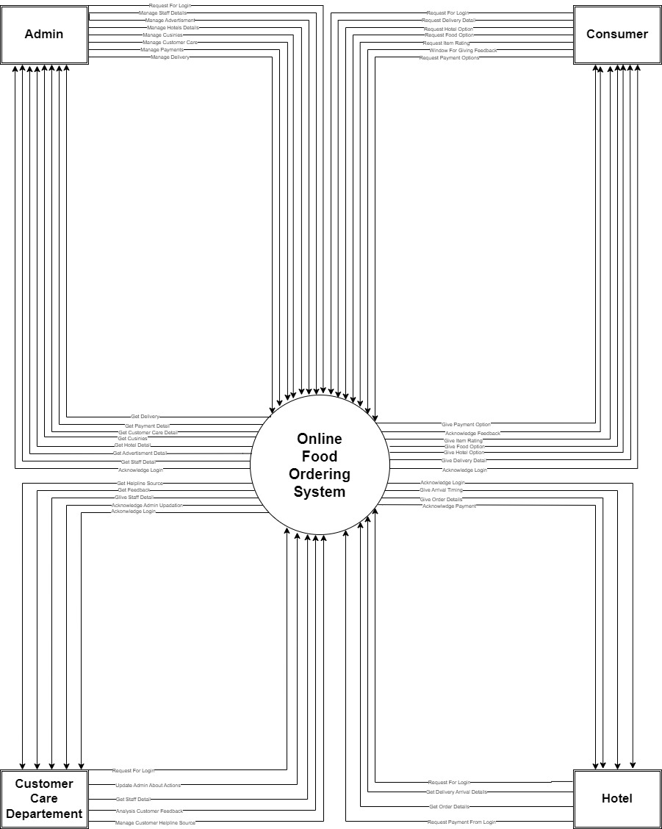

Slide 14
ADMIN
1st Level diagram:

Slide 15
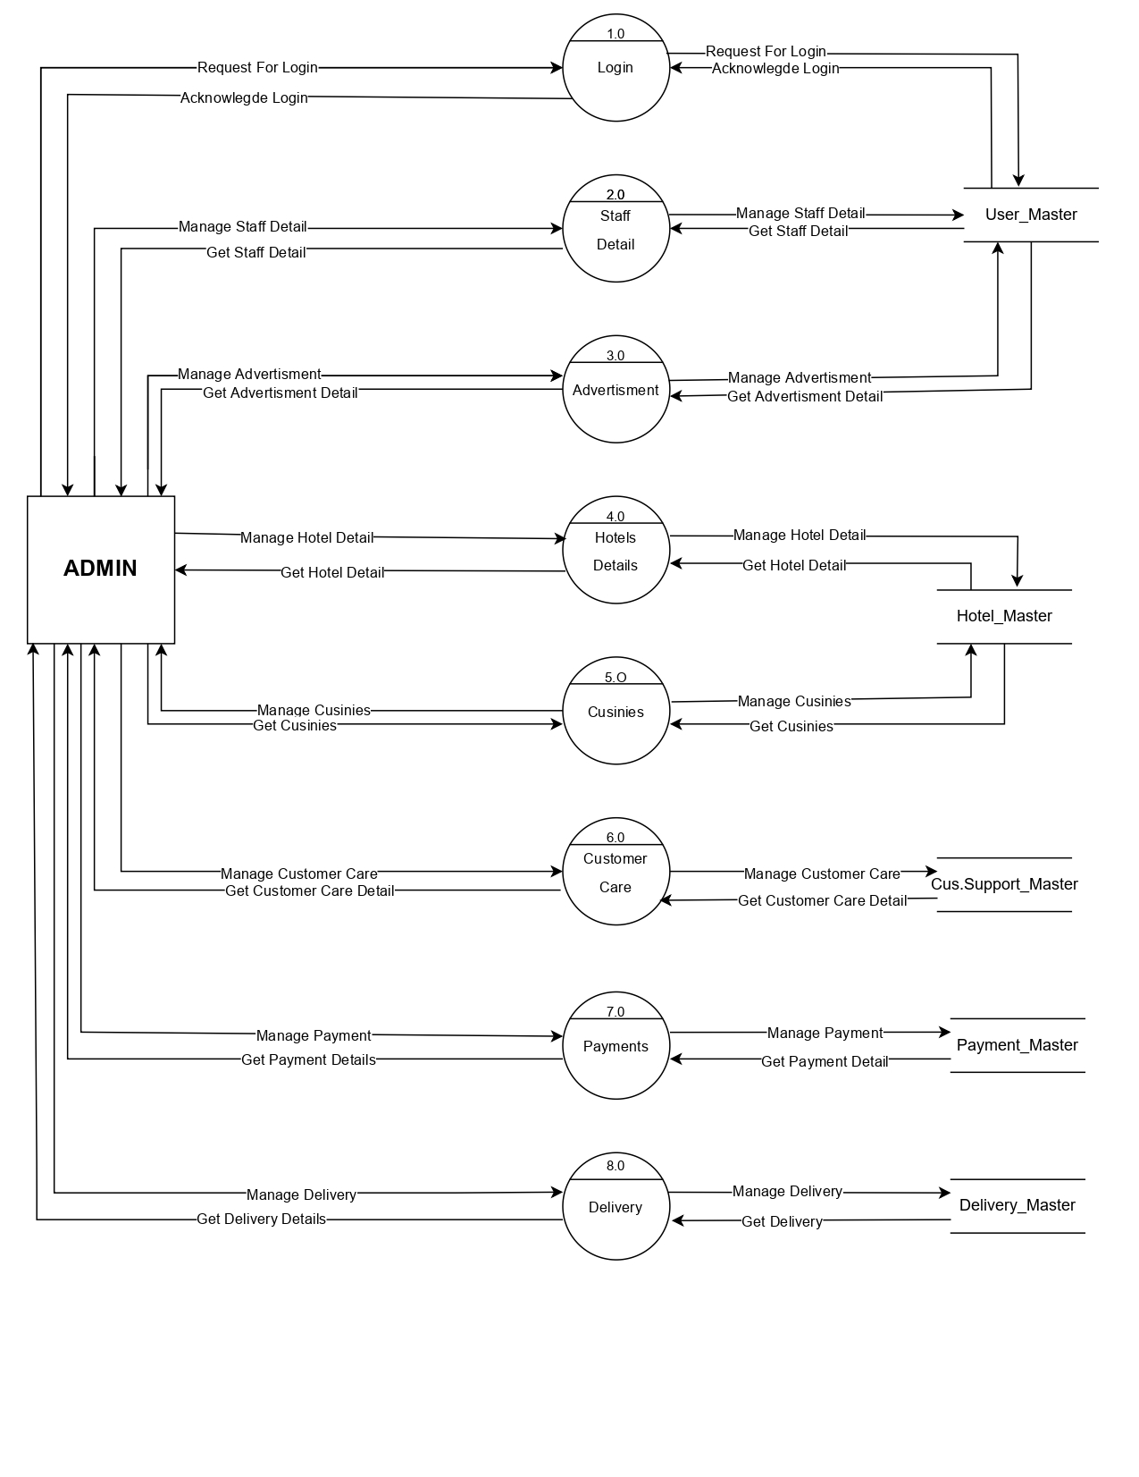

Slide 16
CONSUMER
1st Level diagram:

Slide 17
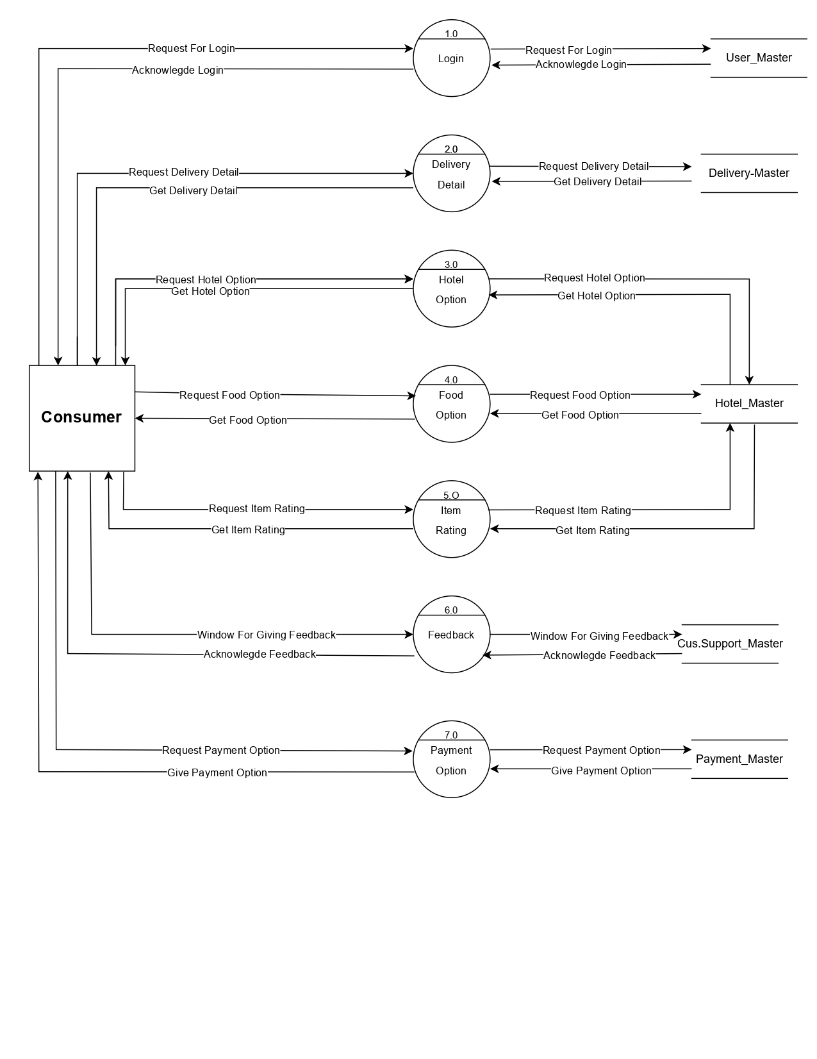

Slide 18
CUSTOMER CARE
1st Level diagram:

Slide 19
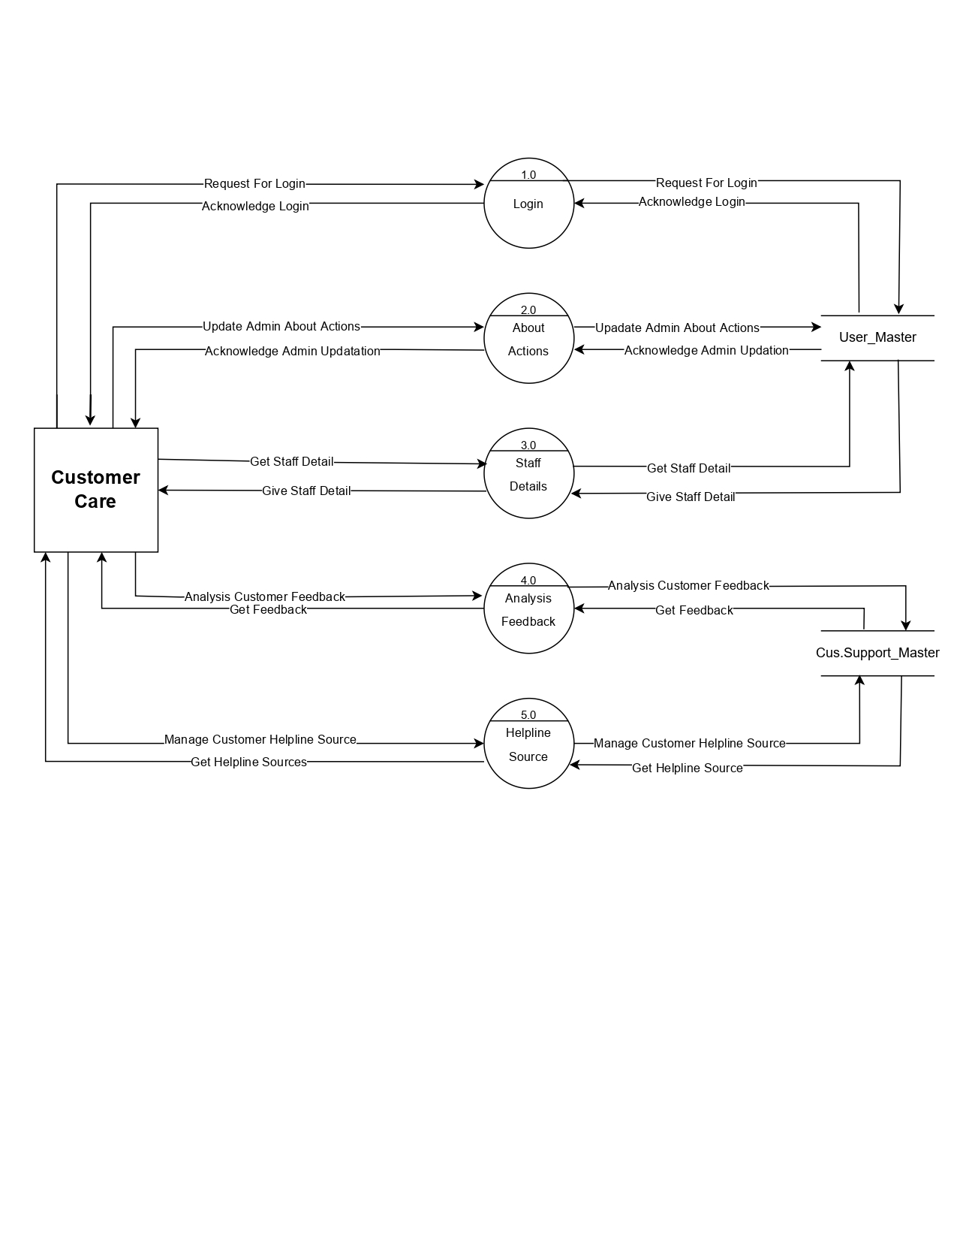

Slide 20
HOTELS
1st Level diagram:

Slide 21
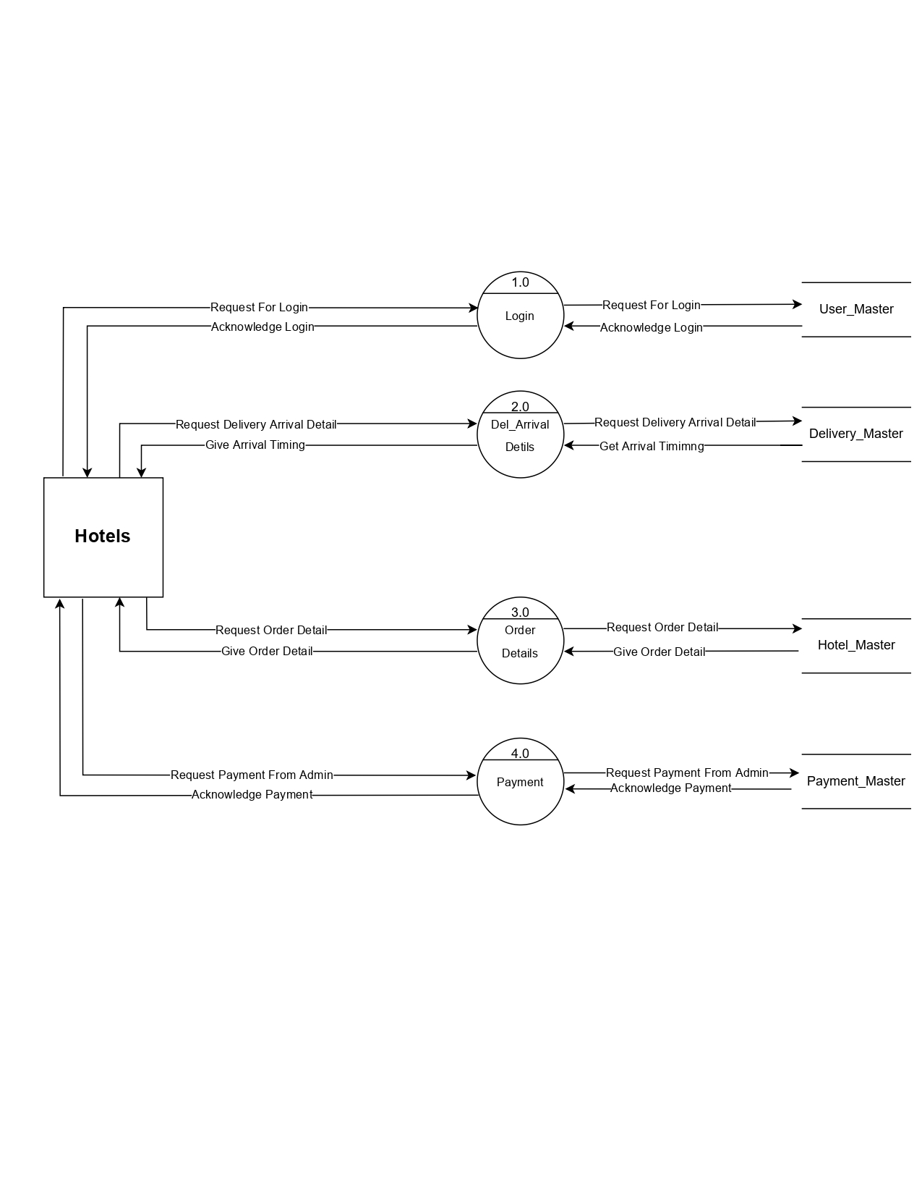

Slide 22
REGISTRATION
2ndLevel diagram:

Slide 23
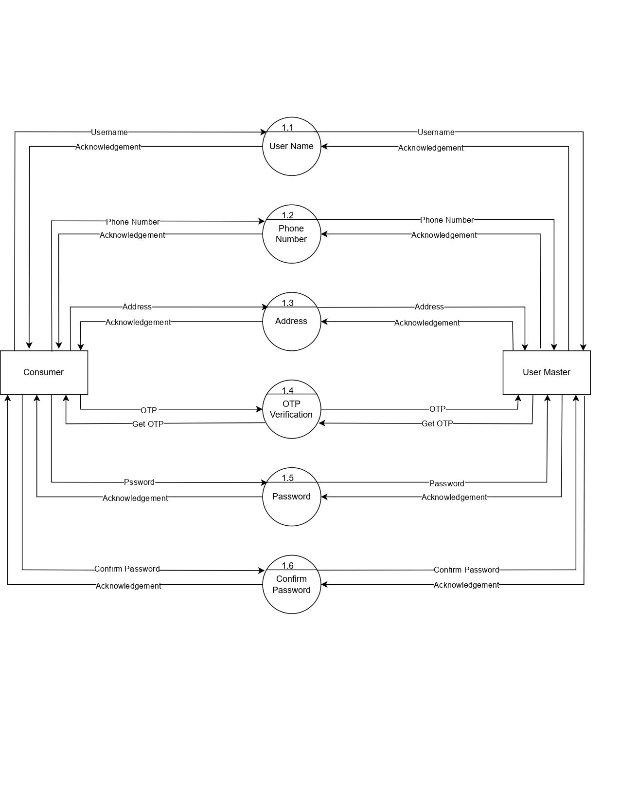

Slide 24
LOG IN
2ndLevel diagram:

Slide 25
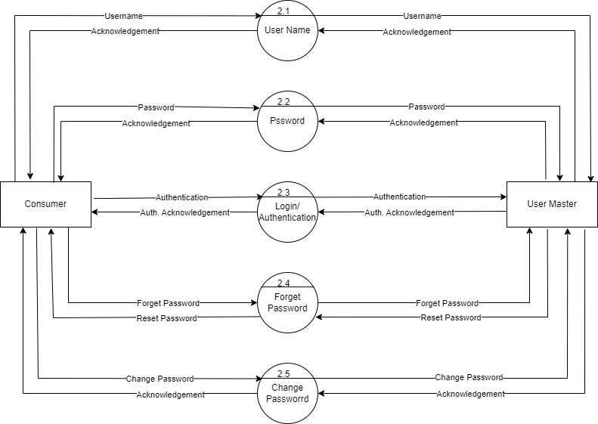

Slide 26
What Is ERD ?
An entity–relationship model (ER model for short)
describes interrelated things of interest in a specific
domain of knowledge. A basic ER model is composed
of entity types (which classify the things of interest) and
specifies relationships that can exist between instances
of those entity types.
What Is Entity ?
An ERD entity is a definable thing or concept within a
system, such as a person/role (e.g. Student) , object
(e.g. Invoice), concept (e.g. Profile) or event (e.g.
Transaction) (note: In ERD, the term "entity" is often
used instead of "table", but they are the same).

Slide 27
What Is Relationship ?
A relationship between two entities signifies that the
two entities are associated with each other somehow.
For example, student might enroll into a course. The
entity Student is therefore related with Course, and the
relationships is presented as a connector connecting
between them.

Slide 28
ER (Entity Relationship) Diagram :

Slide 29
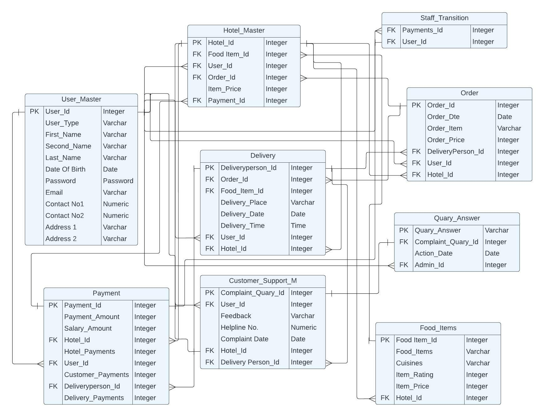

Slide 30
DATA DOCUMENTATION
TABLES:

Slide 31
User_Master
Sr. no | Field name | Datatype | Key | Description
1 | User_Id | Integer | PK | Id of the User.
2 | User_Type | varchar(10) |  | Type/Role of the User.
3 | First_Name | varchar(10) |  | First name of the User.
4 | Second_Name | varchar(10) |  | Second name of the User.
5 | Last_Name | varchar(10) |  | Last name of the User.
6 | Date_of_Birth | Date |  | Date of the birth of User.
7 | Password | Password |  | Password.
8 | Email | Varchar |  | Email of the User.
9 | Contact 1 | Numeric |  | Contact Number.
10 | Contact 2 | Numeric |  | Contact Number.
11 | Address 1 | varchar(20) |  | Address line number 1.
12 | Address 2 | varchar(20) |  | Address line number 2.

Slide 32
Hotel_Master
Sr. no | Field Name | Datatype | Key | Description
1 | Hotel_Id | Integer | PK | Id of the Hotel
2 | Food Item_Id | Integer | FK | Id of the Food item.
3 | User_Id | integer | FK | Id of the Hotel.
4 | Order_Id | Integer | FK | Id of the order placed.
5 | Item_Price | Integer |  | Price of all items.
6 | Payment_id | Integer | FK | Id of the payments.

Slide 33
FOOD_ITEMS
Sr. no | Field Name | Datatype | Key | Description
1 | Food Item_Id | Integer | PK | Id of the Food item.
2 | Food_Items | varchar(20) |  | Name of Food Items.
3 | Cuisines | varchar(20) |  | Name of all cuisines.
4 | Item_Rating | Integer |  | Rating of item.
5 | Item_Price | Integer |  | Price of all items.
6 | Hotel_ID | Integer | FK | Id of the hotel.

Slide 34
Customer_Support_M
Sr. no | Field Name | Datatype | Key | Description
1 | Complaint_Query_Id | Integer | PK | Id of the Complaint.
2 | User_Id | Integer | FK | Id of the user.
3 | Feedback | varchar(20) |  | Feedback of consumer.
4 | Helpline_no. | Numeric |  | Helpline Contact No.
5 | Complaint_Date | Date |  | Date of the complaint.
6 | Hotel_ID | Integer | FK | ID of the Hotel.
7 | Delivery Person_ID | Integer | FK | ID of Delivery Person.
8 | Query_Answer_ID | Integer | FK | ID of reply given to query.
9 | Complaint | varchar(20) |  | Complaint by the user.

Slide 35
Payment
Sr. no | Fieldname | Datatype | Key | Description
1 | Payment_Id | Integer | PK | Id of the payments.
2 | Salary_amount | Integer |  | Amount of Salary.
3 | Hotel_ID | Integer | FK | Id of the Hotel.
4 | Hotel_payments | Integer |  | Payments to hotel.
5 | User_Id | Integer | FK | Id of the user.
6 | Customer_payments | Integer |  | Payments of Customers.
7 | Deliveryperson_Id | Integer | FK | Id of Delivery person.
8 | Delivery_Payments | Integer |  | Payments of Delivery.

Slide 36
Delivery
Sr. no | Field name | Datatype | Key | Description
1 | Deliveryperson_Id | Integer | PK | Id of the delivery person.
2 | Order_Id | Integer | FK | Id of the order received.
3 | Food_Item_Id | Integer | FK | Id of the item.
4 | Delivery_place | varchar(20) |  | Place of the Delivery
5 | Delivery_Date | Date |  | Date of the delivery.
6 | Delivery_time | Time |  | Time of the delivery.
7 | User_ID | Integer | FK | Id of the user to be delivered.
8 | Hotel_ID | Integer | FK | Id of hotel from which delivery takes place.

Slide 37
Order
Sr. no | Field name | Datatype | Key | Description
1 | Order_Id | Integer | PK | Id of the order.
2 | Order_Date | Date |  | Date of the order.
3 | Order_Item | varchar(20) |  | Item ordered.
4 | Order_Price | Integer |  | Price of the order placed.
5 | Delivery_Person_ID | Integer | FK | Id of the Delivery person.
6 | User_Id | Integer | FK | Id of the User.
7 | Hotel_Id | Integer | FK | Id of hotel from which order took place.

Slide 38
Query_Answer
Sr. no | Field name | Datatype | Key | Description.
1 | Query_Answer | varchar(20) | PK | Complain Received.
2 | Complaint_Query_Id | Integer | FK | Id of the Complaint query.
3 | Action_Date | Date |  | Date of Action Taken.
4 | Admin_ID | Integer | FK | ID of the admin.
5 | Resolution_Status | Boolean |  | It tells if problem is solved.

Slide 39
Identification page

Slide 40
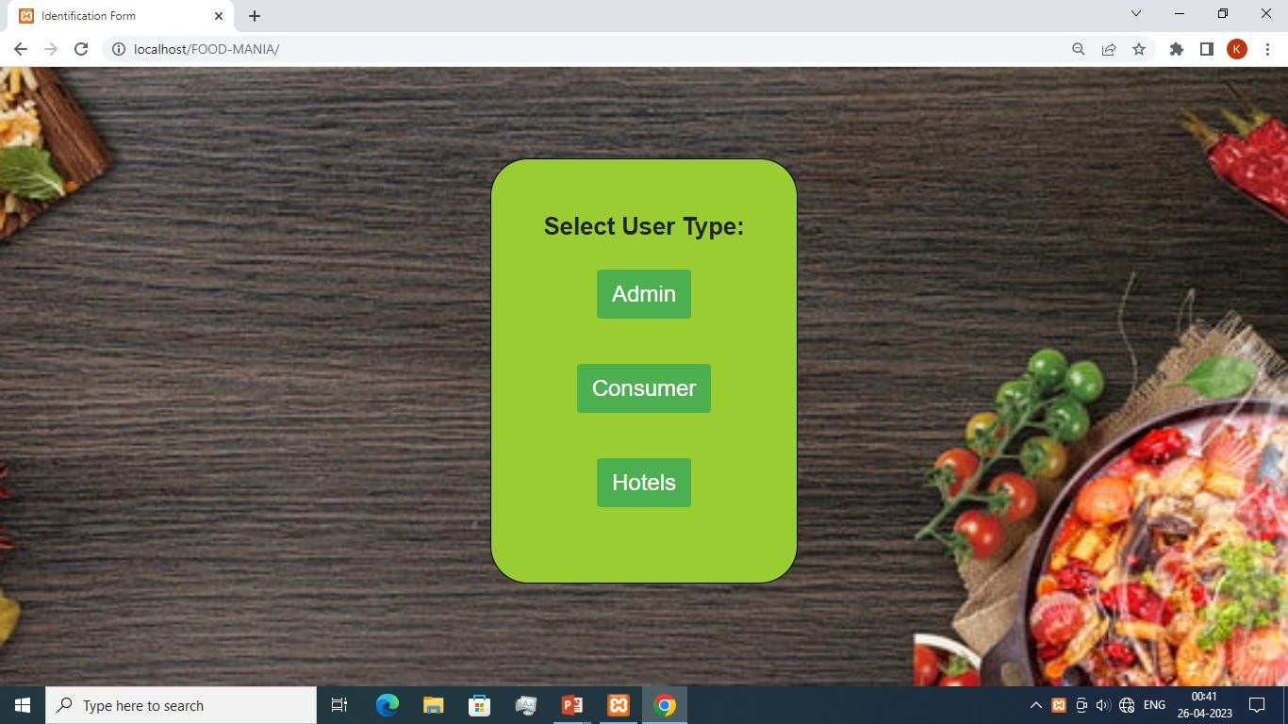
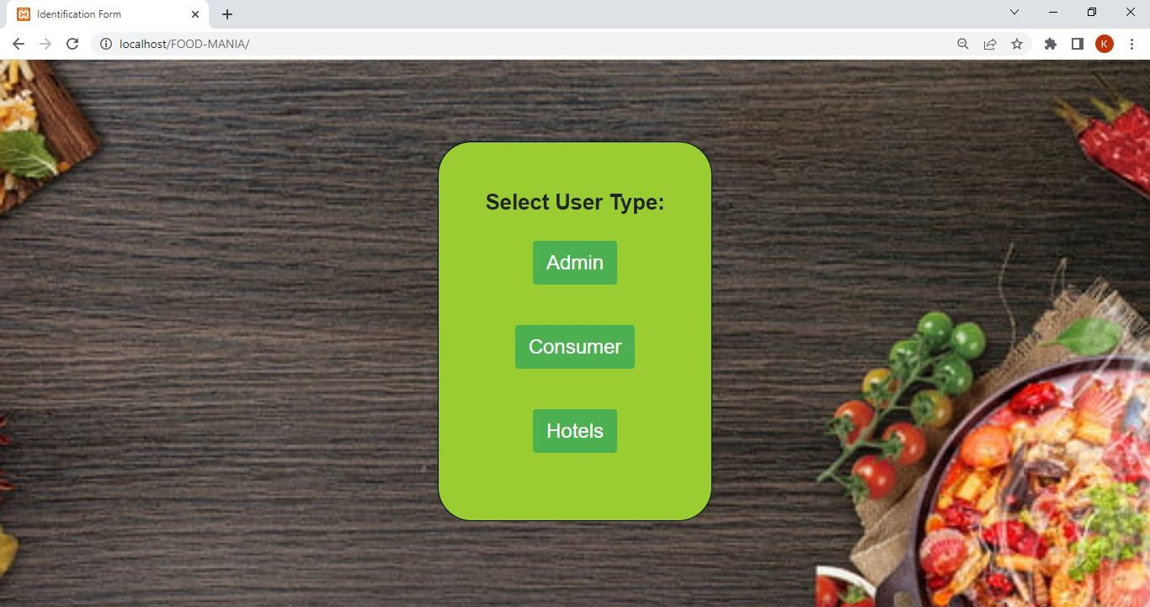

Slide 41
Admin-Site

Slide 42
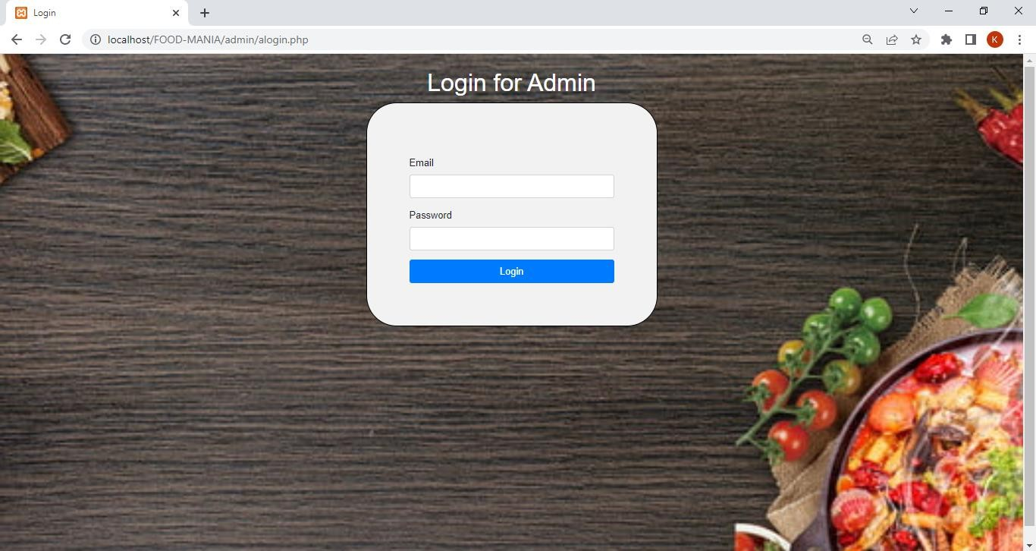
Admin login-window

Slide 43
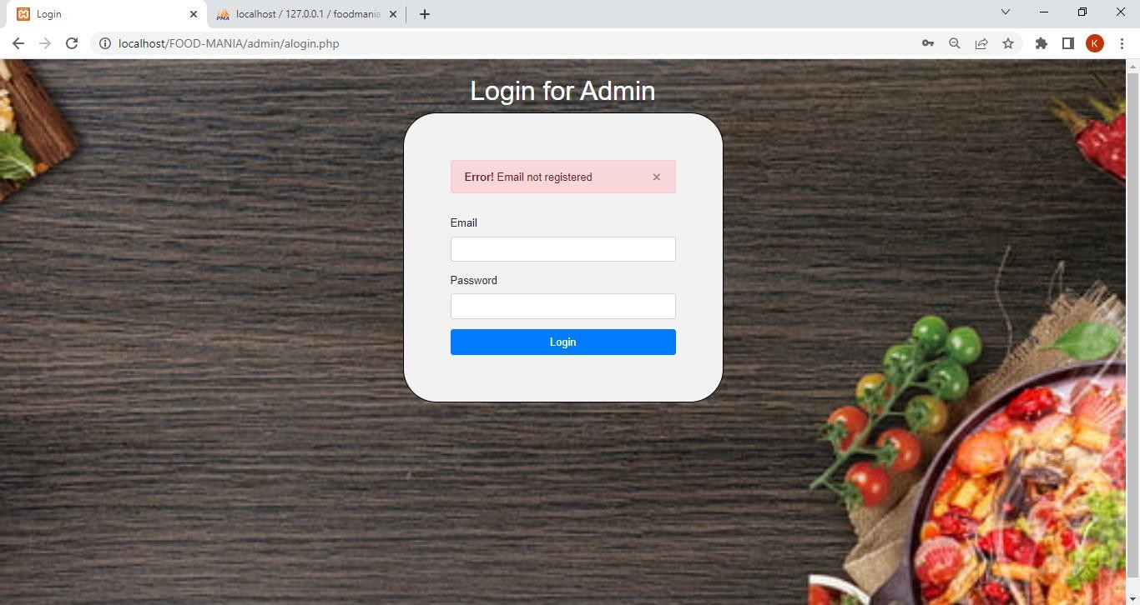
Login with wrong Email

Slide 44
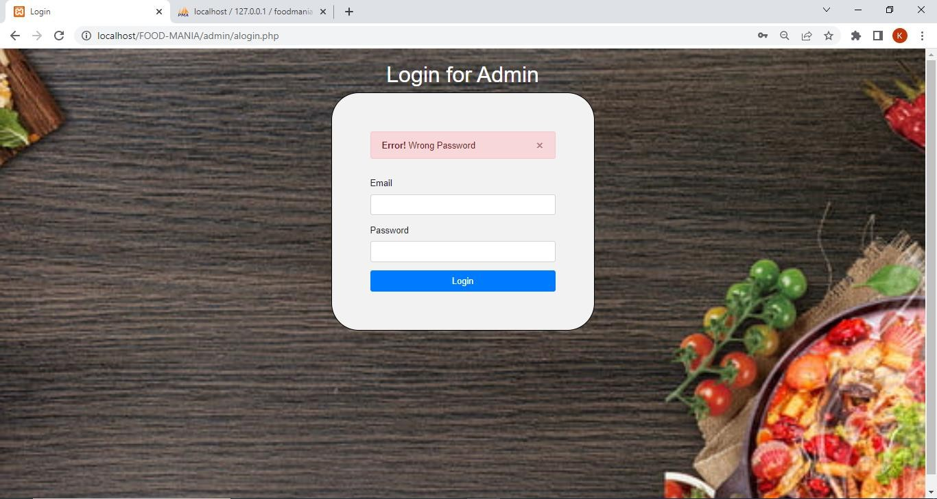
Login with wrong password

Slide 45
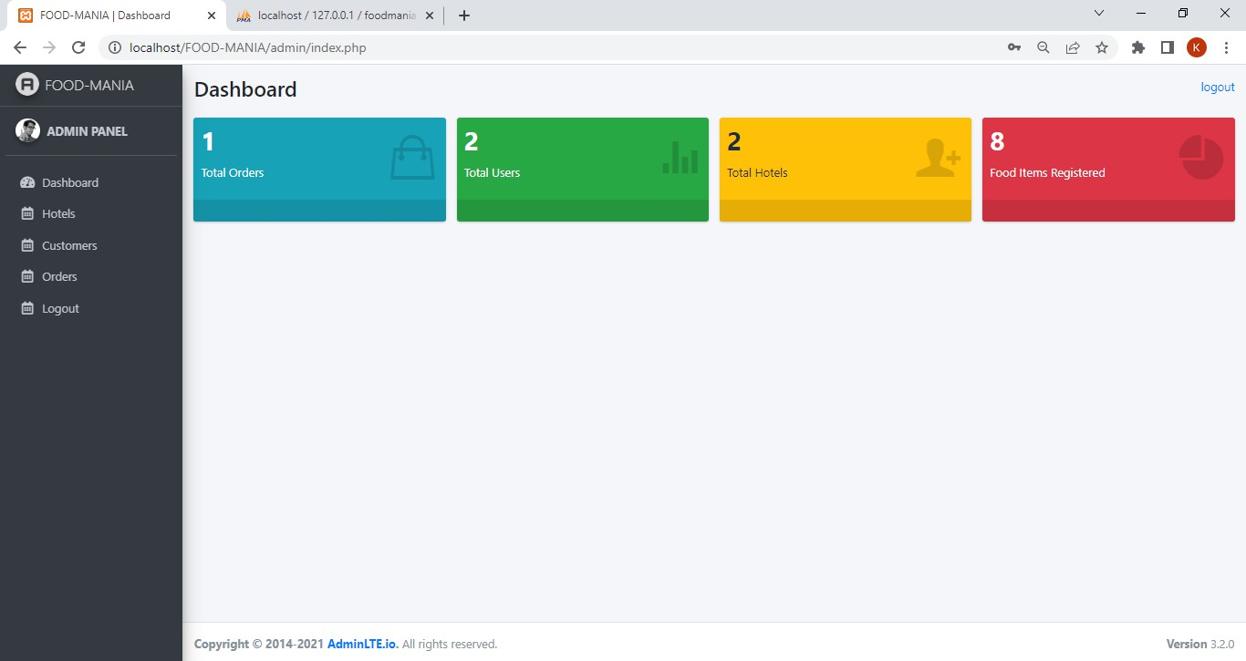
Dashboard after successful login

Slide 46
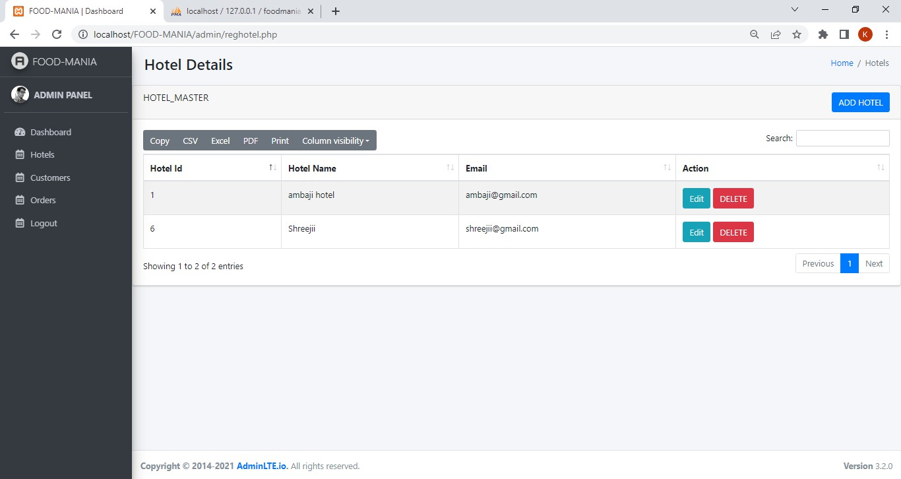
Hotels side(Admin view)

Slide 47
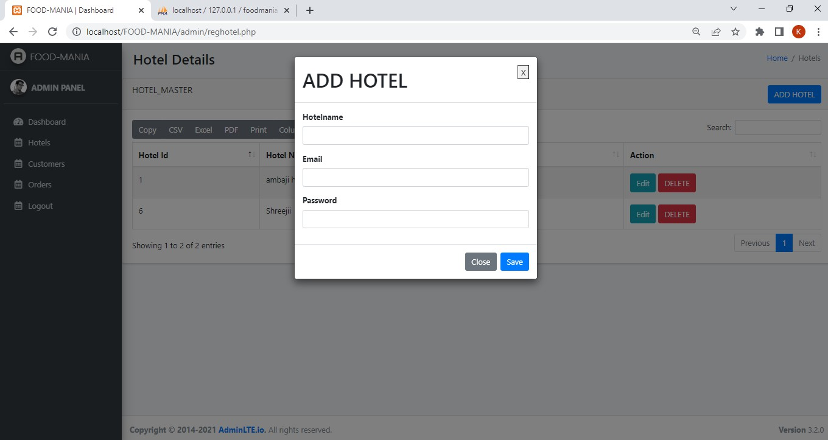
Hotel side(Admin view)-Add Hotel

Slide 48
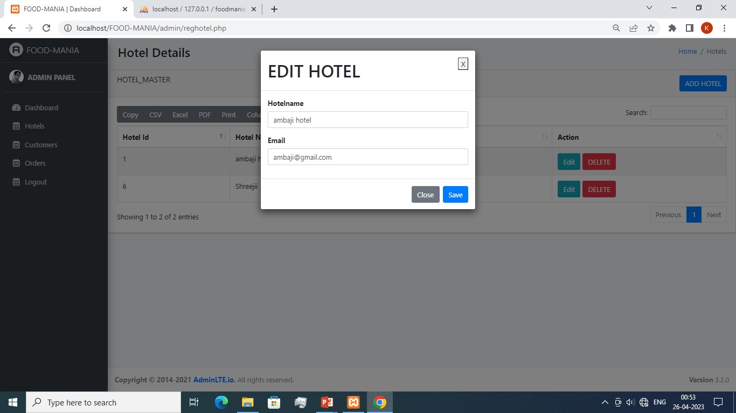
Hotels side(Admin view)-Edit option

Slide 49
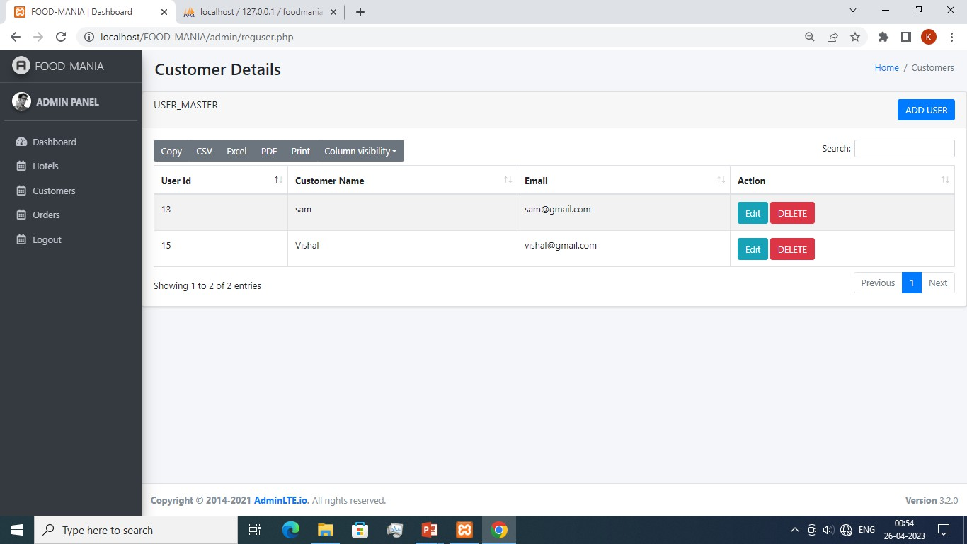
Consumer side(Admin view)

Slide 50
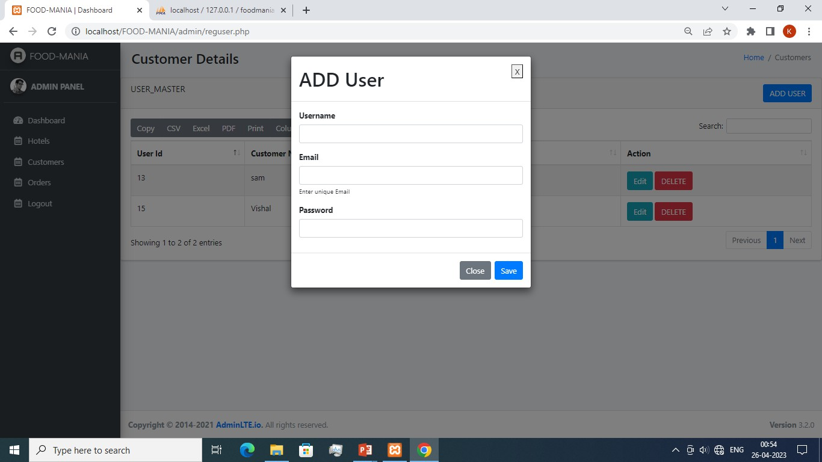
Customer side(Admin view)-Add Customer

Slide 51
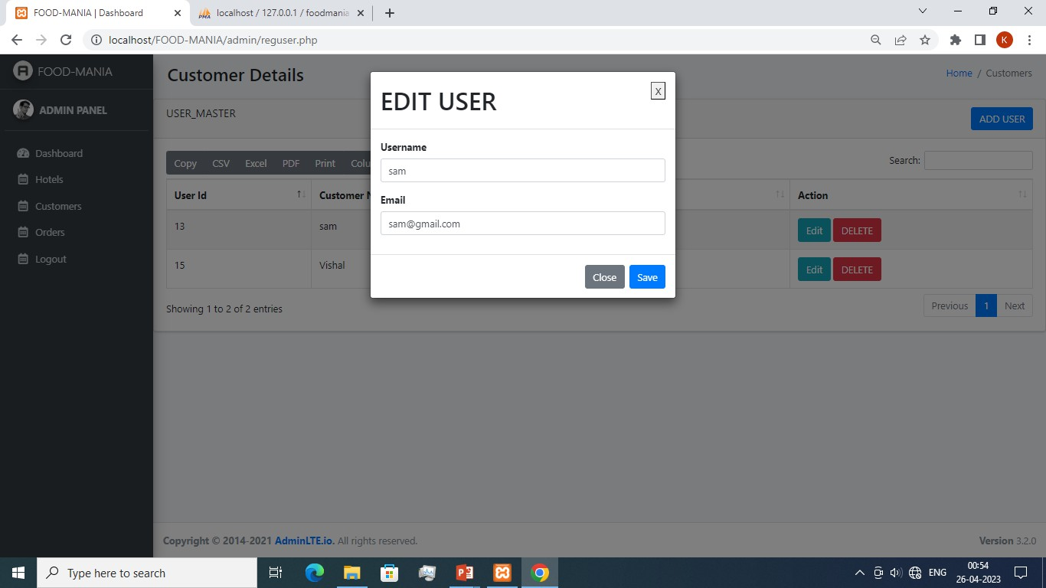
Customers side(Admin view)-Edit details

Slide 52
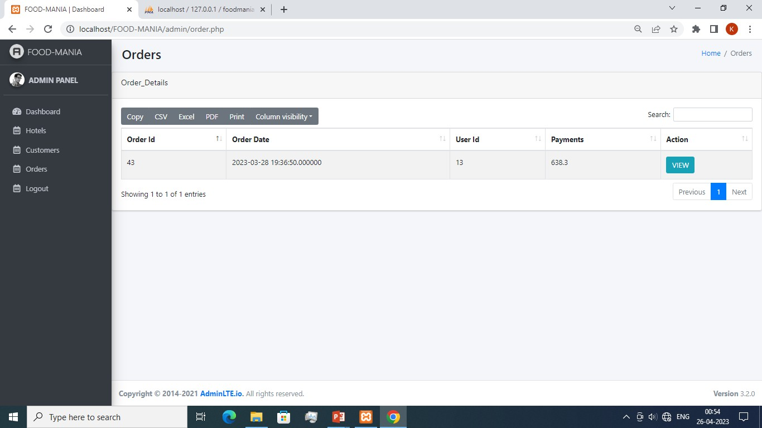
Order List(Admin view)

Slide 53
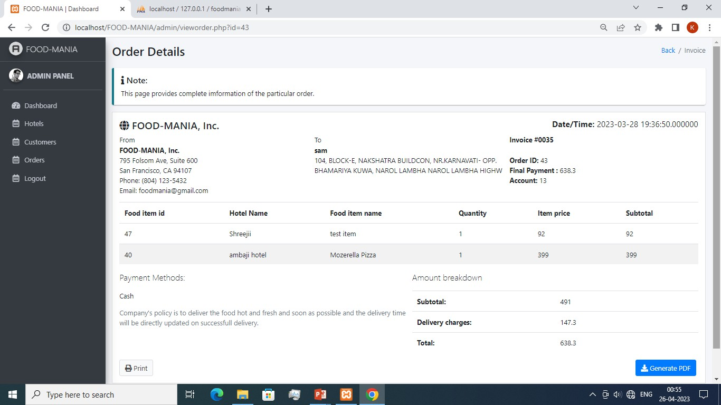
Order view(Admin view)

Slide 54
Consumer-side

Slide 55
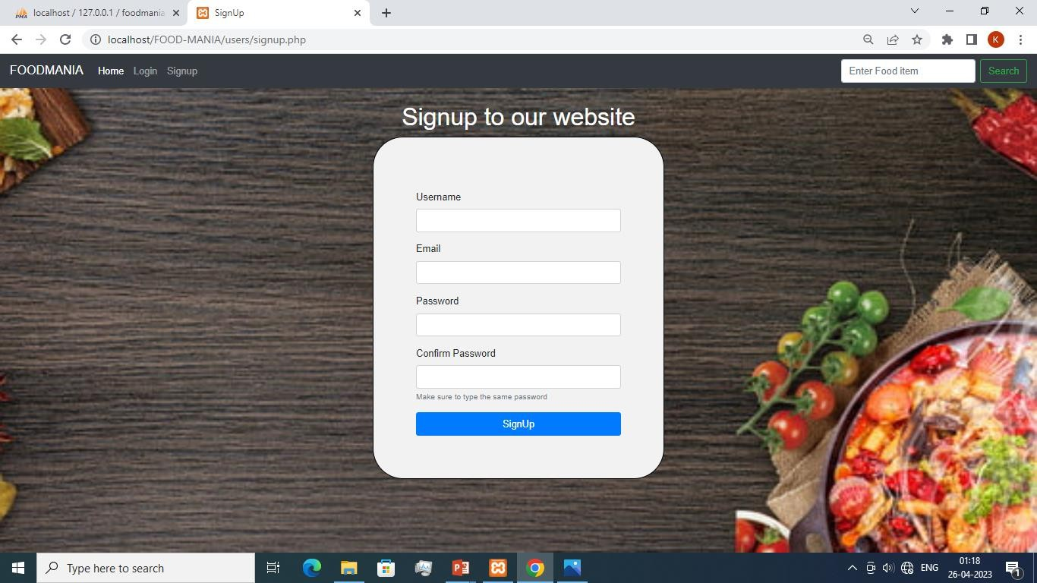
Consumer side(Signup-window)

Slide 56
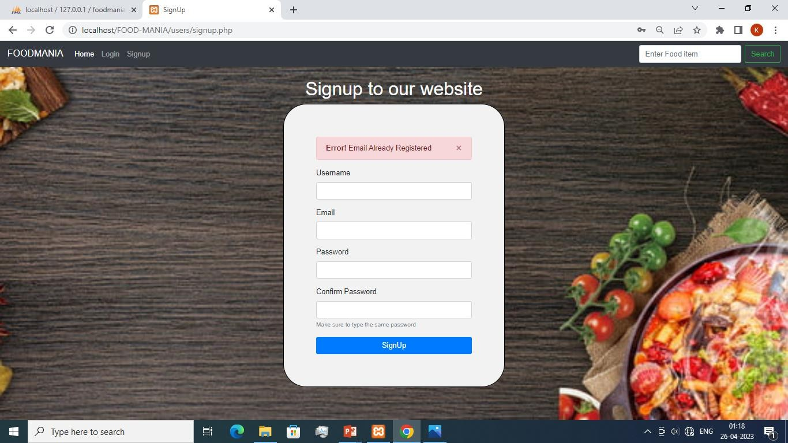
Consumer side(Signup-window)-registered Email

Slide 57

Consumer side(Signup-window)-Diff. Password entered

Slide 58
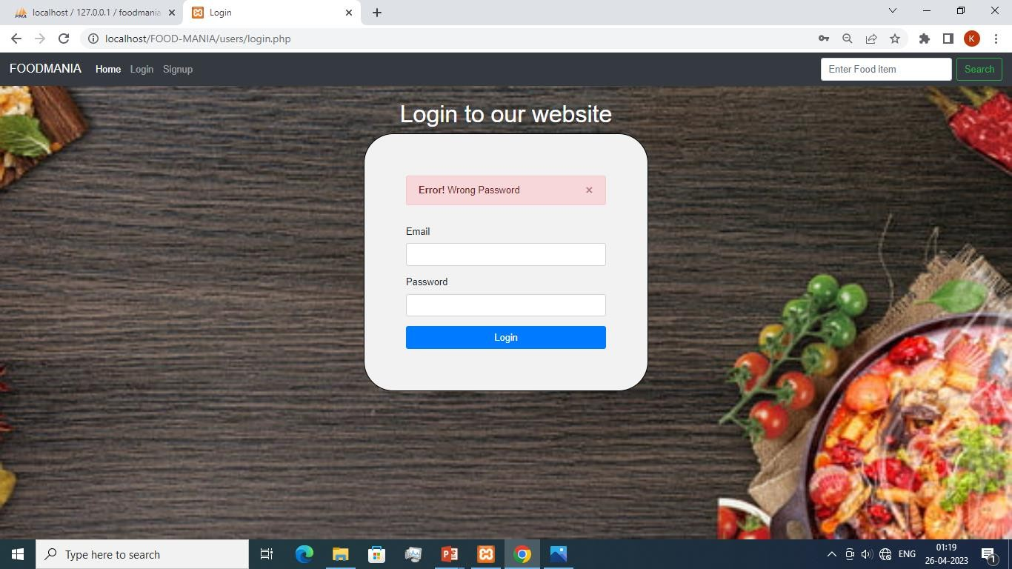
Consumer side(login-window)-wrong Password

Slide 59

Consumer side(Login-window)-Unregistered Email

Slide 60
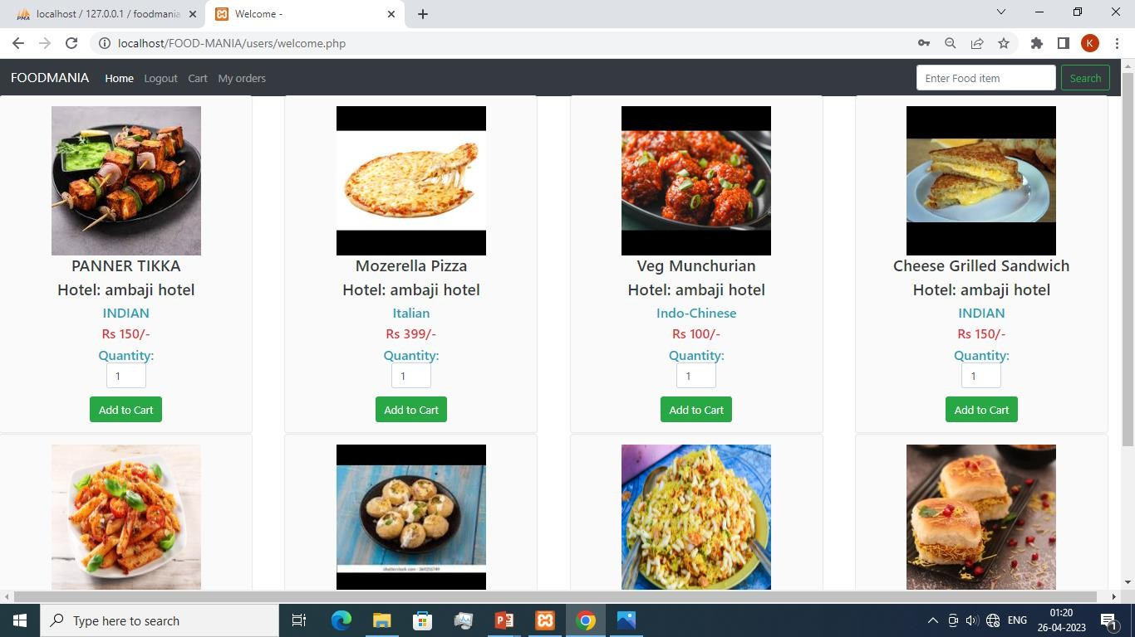
Consumer side- Home window

Slide 61
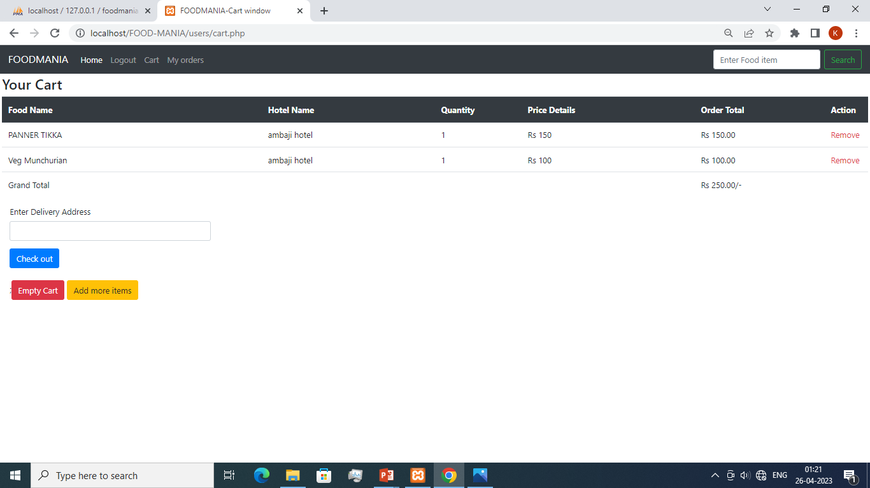
Consumer side - Cart view

Slide 62
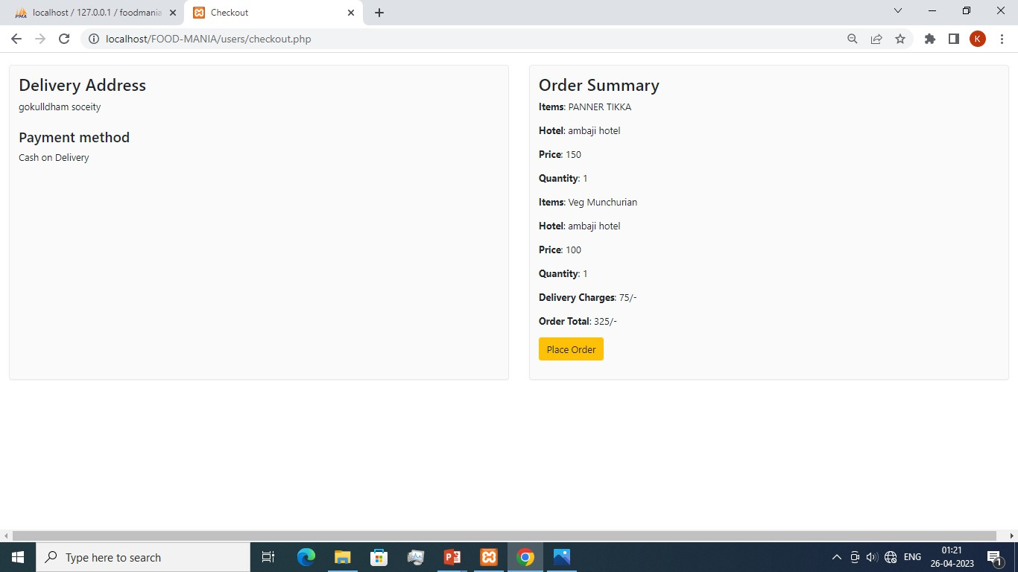
Consumer side- Checkout Window

Slide 63
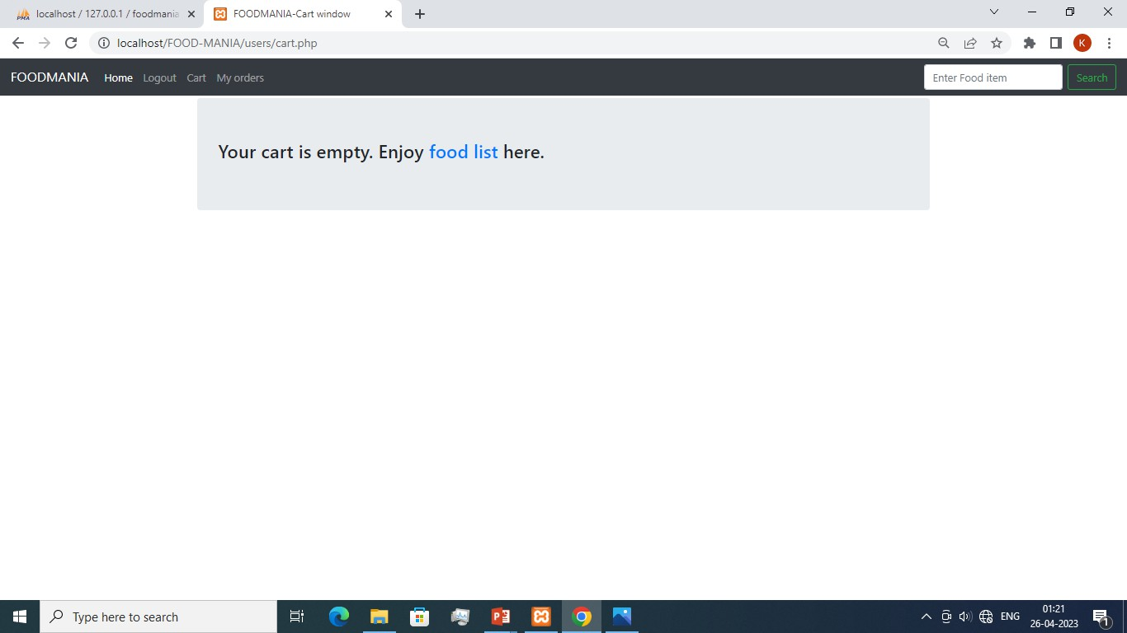
Consumer side- Empty cart

Slide 64
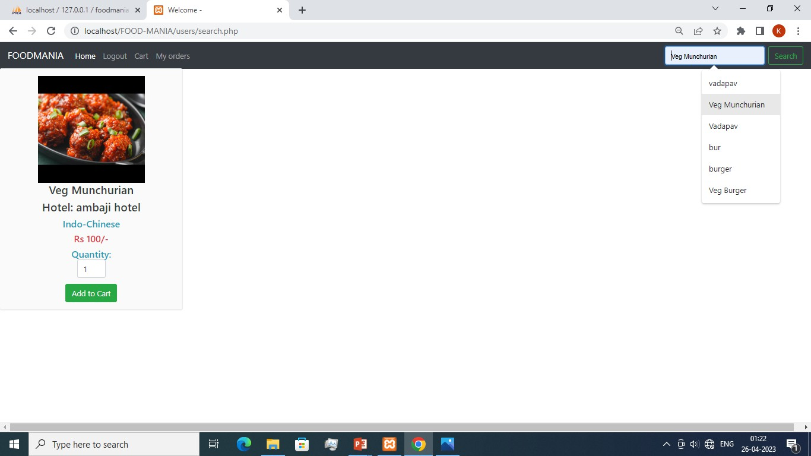
Consumer side-Search window

Slide 65
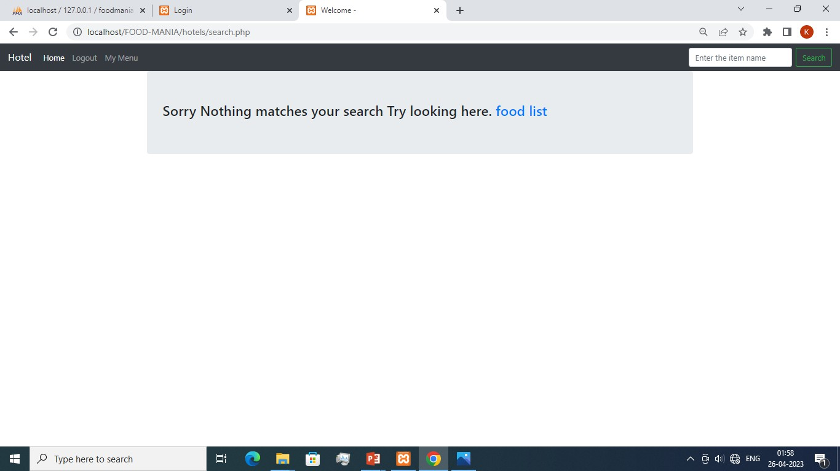
Consumer side- Search (When searched item is not in Database)

Slide 66
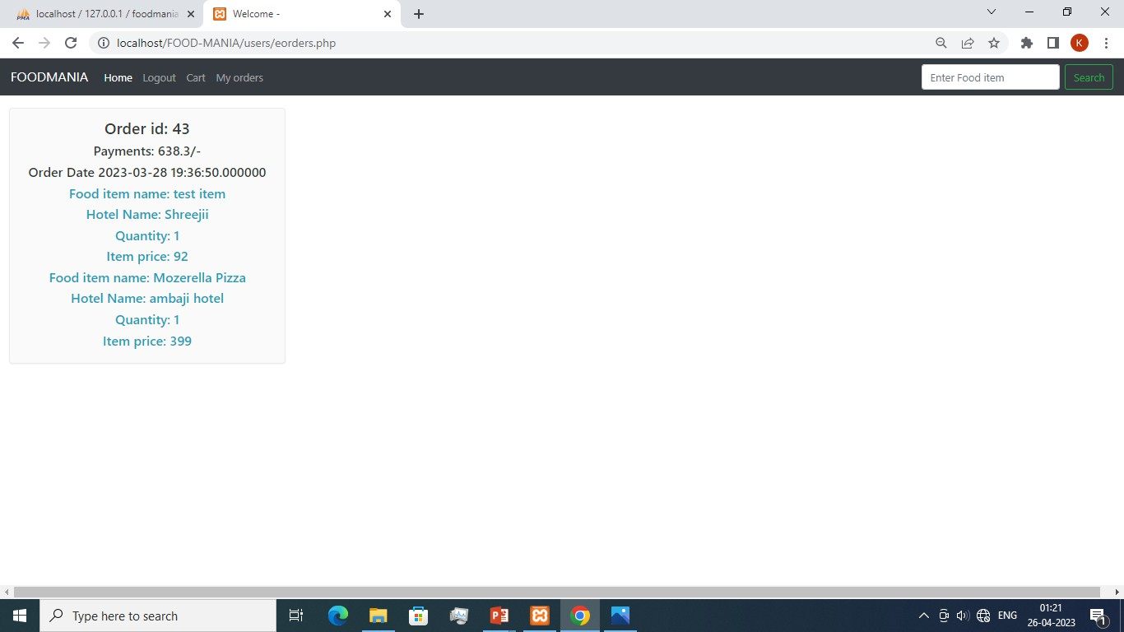
Consumer side- Previous order record

Slide 67
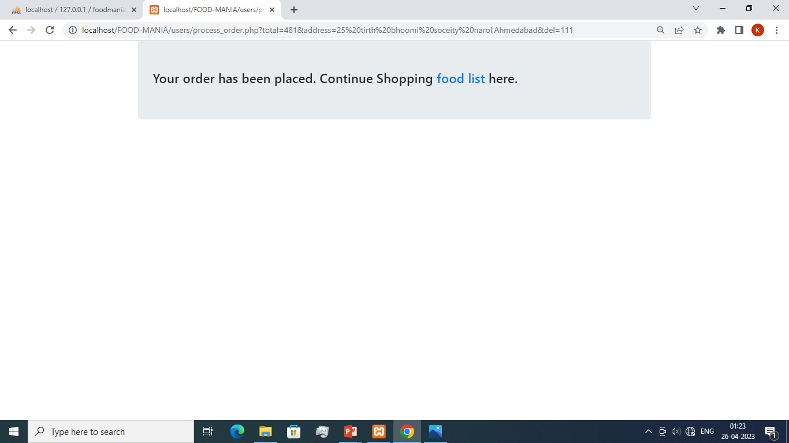
Consumer side Successful Order placed

Slide 68
Hotel-side

Slide 69
Hotel side(Signup-window)

Slide 70
Hotels side(Signup-window)-registered Email

Slide 71
Hotels side(Signup-window)-Diff. Password entered

Slide 72
Hotels side(login-window)-wrong Password

Slide 73
Hotels side(Login-window)-Unregistered Email

Slide 74
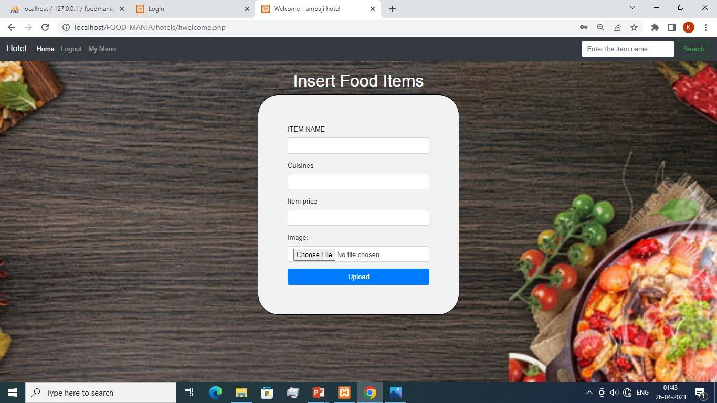
Hotels side (Inserting a new food item)

Slide 75
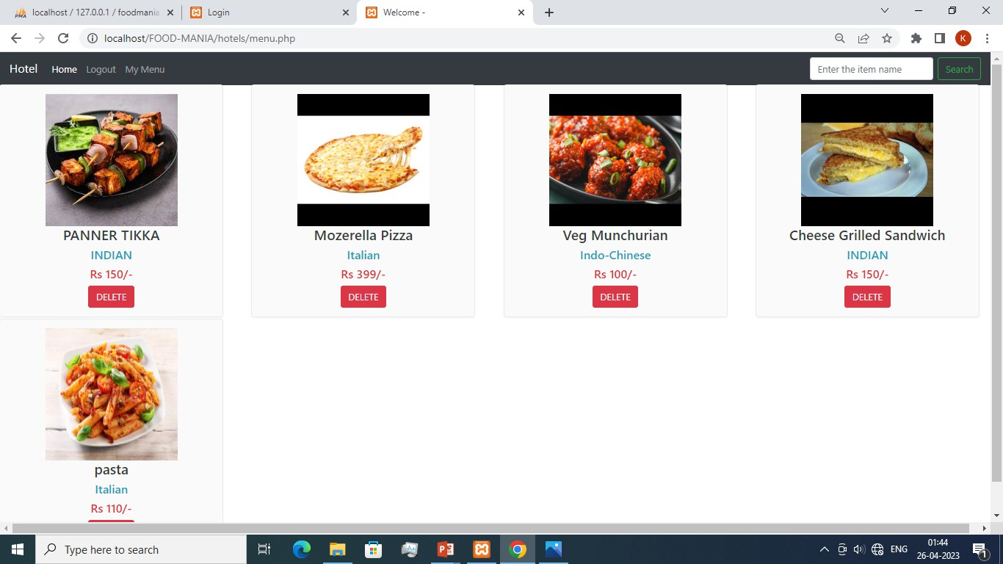
Hotels side- Existing menu

Slide 76
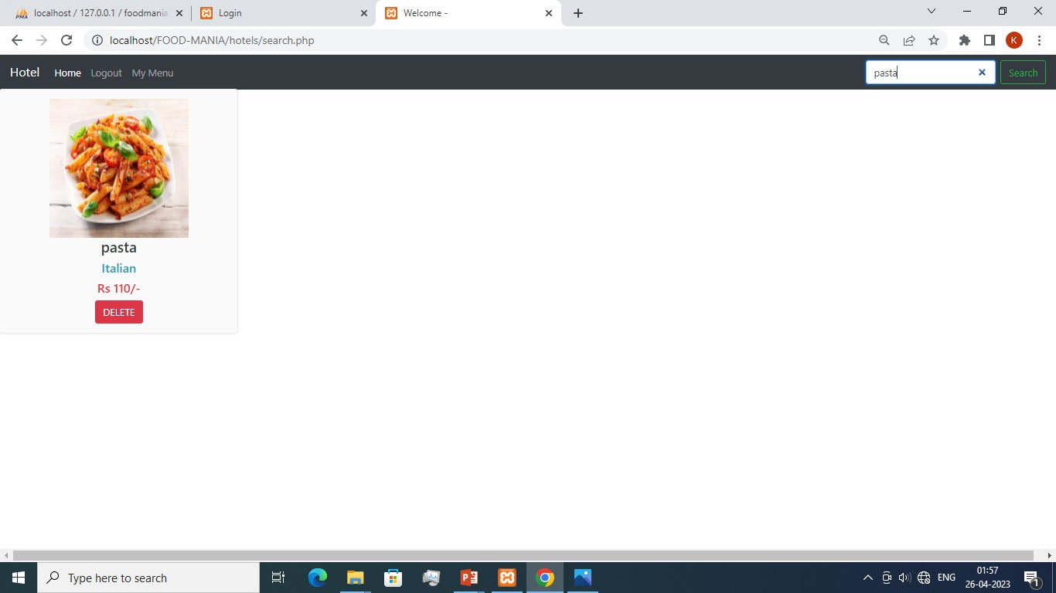
Hotels side- Search

Slide 77
Hotels side- Search (When searched item is not in Database)

Slide 78
Conclusion
Online Food ordering System is very useful and convenient to both Consumers and Hotels it provides a common place for both parties to conceive their Businesses.
This System not only provides the consumers a way to satisfy their taste cravings while sitting in their home with few clicks, but also is beneficial to businesses lesser known to consumers but can be attracted with nice ratings and reviews.

Slide 79
Bibliography
INTERNET HELP :-
www.google.com

Slide 81

THANK YOU

